Slide 1


DSN2098 Project Exhibition-I
REVIEW - 1

Slide 2
GROUP MEMBERS
20BCE10355 - Smitesh
20BCE10360 - Tejas Gawali
20BCE10843 - Aryan Singh
20BCE10798 - Khush Bubna
20BCE11049 - Areeb Ahmad Siddiqui

Slide 3
01.
About the project
INTRODUCTION

Slide 4
About the project
Healthcare is the basic need of human being. The category of patients involves all human beings housewives, businessmen, students, teachers, service men and also all of them have a busy hectic schedule. Today’s life is full of responsibilities and stress. So, people are prone to diseases of different types and it is one’s own duty to make themselves fit and healthy.
In day to day life, it is difficult for one person to remind the other of their daily intake of medicines. In our developing and technology dependent life we totally rely on gadgets. With this, we get an opportunity to use technology in a better way so that it can be made useful to us. And it plays an important part in our daily life and helps us staying fit in many ways.

Slide 5
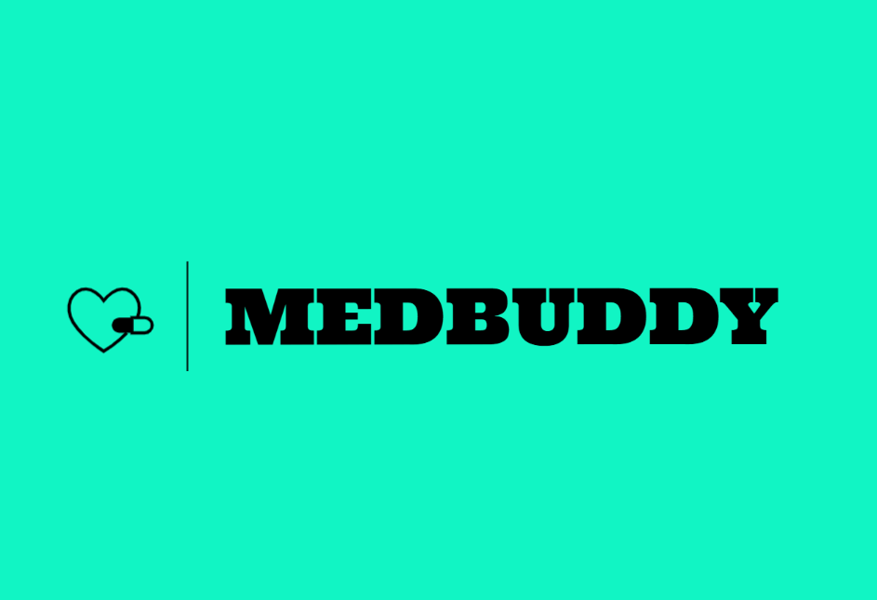
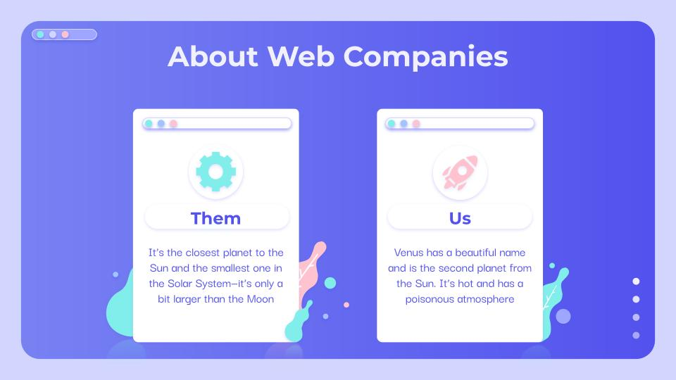
We are introducing an Web application named MEDBUDDY, whose objective is to remind the patients of their dosage timings so that they can stay fit and healthy. Through this they may remember which medicine is to be taken. This application focusses on the people who forget to take medicines on time.
The patients may even have emergency doctor’s contact information disease wise. Medication reminders help in decreasing medication dispensing errors and wrong dosages.
The application is designed such that it can be helpful for busy people and old age people and even can spread health care awareness. It is life-saving, money saving and time-saving application which is easy to use and provides a good user interface.

Slide 6
Our goals
ACCURATE
USABILITY
THE APPLICATION WILL BE ACCURATE AND RELIABLE ENOUGH TO PROVIDE DETAILS OF PRESCRIBED MEDICATION
EASY TO USE
USER-INTERFACE TO BE USED BY ANYONE IN THE FAMILY

Slide 7
EXISTING WORK WITH LIMITATIONS
02.
Many Medication Systems have been developed based on different platforms and concepts. Use of healthcare-related apps is growing but there are many issues related to their functionality. Our MEDBUDDY is a medication reminder system for busy people and old age people. Our application provides user interfaces for configuring medication schedules and user alerts for reminding users about the time and type of medication.
There are many loopholes in existing reminder systems. To list a few:
They do not provide Doctors, contact details no optional notification only compulsion.
The scheduled reminder does not suggests any kind of medicine, a dose of medicine, etc. automatically of the medicine to be taken.
Lastly, many of the systems available require special hardware which needs to be purchased.

Slide 8
PROPOSED WORK AND METHEDOLOGY
03.

Slide 9
NOVELTY OF PROJECT
04.
It is estimated that 50% of the 2 billion prescriptions filled each year are not taken correctly. Forgetting is the most frequently reported reason among patients for nonadherence. It is definitely not the wisest thing to forget taking medicines as missing even a single dosage can worsen the health and often time.
In case of chronic health diseases, may even lead to the death of patients. Thus, these people who tend to forget to take their pills can immensely benefit from the web app that remind users to take their medications.
It also helps in preventing errors by ensuring people don't end up taking the wrong medicines or skip dosages.

Slide 10
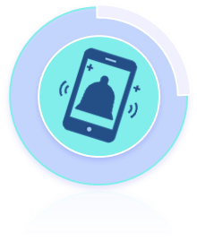
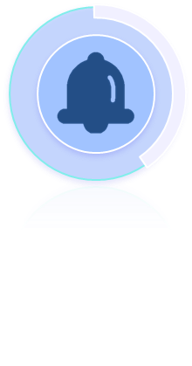

05.
REAL LIFE USAGE
Notifies you about your medication
Refill reminders sets reminders to the date when medication needs to be refilled
Availability of a medication database that allows the user to search and select a medication from the database.

Slide 11
WHY DO WE NEDD THIS?
06.
If you are taking multiple medications it gets hard to remember why you take certain medications.
It also gets complicated when you might have multiple medications for multiple different reasons or illnesses.
You should be aware of the medication you take and why exactly you take it.
Your family members or friends should also be aware of the medication you are taking in case of emergencies.

Slide 12
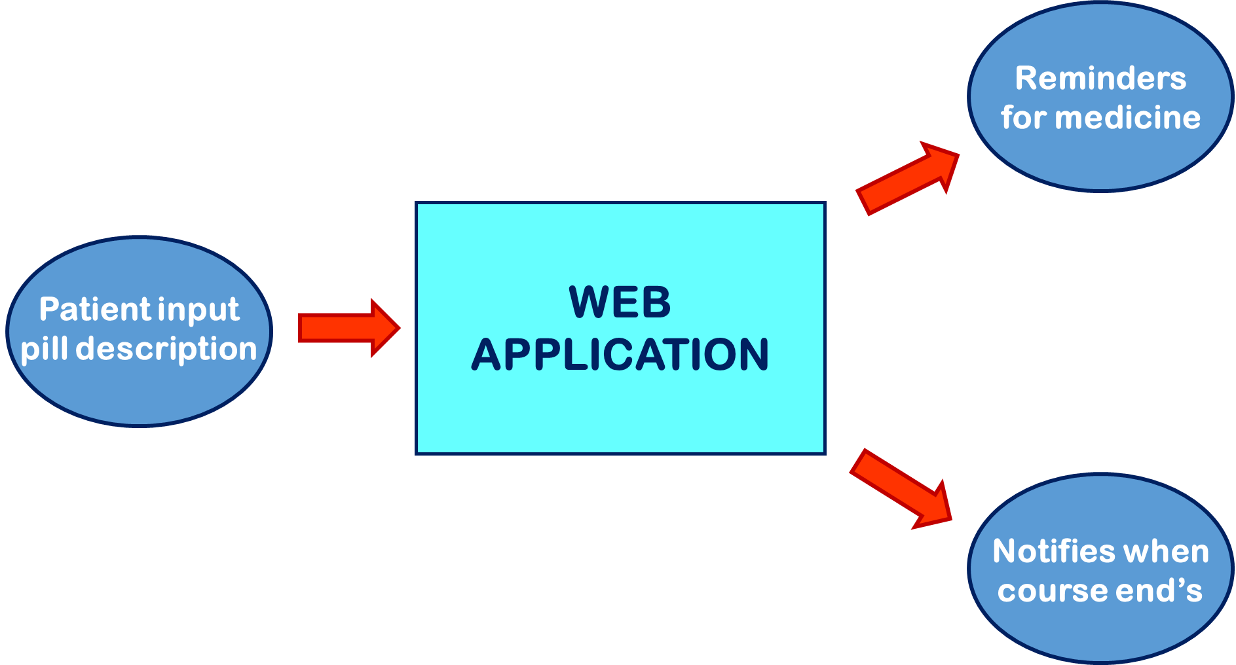
07.
ARCHITECTURE

Slide 13
MODULE SPLIT-UP
MODULE 1
MODULE 2
08.
Basics of HTML; The tags-attributes-classes-ids-block-elements-inline elements, How the basic structure of website look.
In this module we shall make the overall structure of our website, including the necessary containers tabs etc.
HTML
CSS
BOOTSTRAP
JAVA SCRIPT
Basics of Cascading Style Sheets (CSS); Container properties, colours-borders-alignment-fonts-forms-buttons;
In this module we shall style the overall look of our website syncing with the html page created already creating a responsive display.

Slide 14
MODULE SPLIT-UP
MODULE 3
MODULE 4
Basics of JavaScript; data types, built-in methods, and variables. if, else statements, scoping objects ,functions
In this modules we shall use JavaScript and give life to all the functions
HTML
CSS
BOOTSTRAP
JAVA SCRIPT
Basics of Bootstrap; Built-in Support ,functions, CSS, components ,jQuery plug-ins etc.
In this module we shall use the functions of bootstrap to modify the websites and make it more functional

Slide 15
THANK YOU

